Slide 1

CHIKV Mac
Fragment Progression

Slide 2
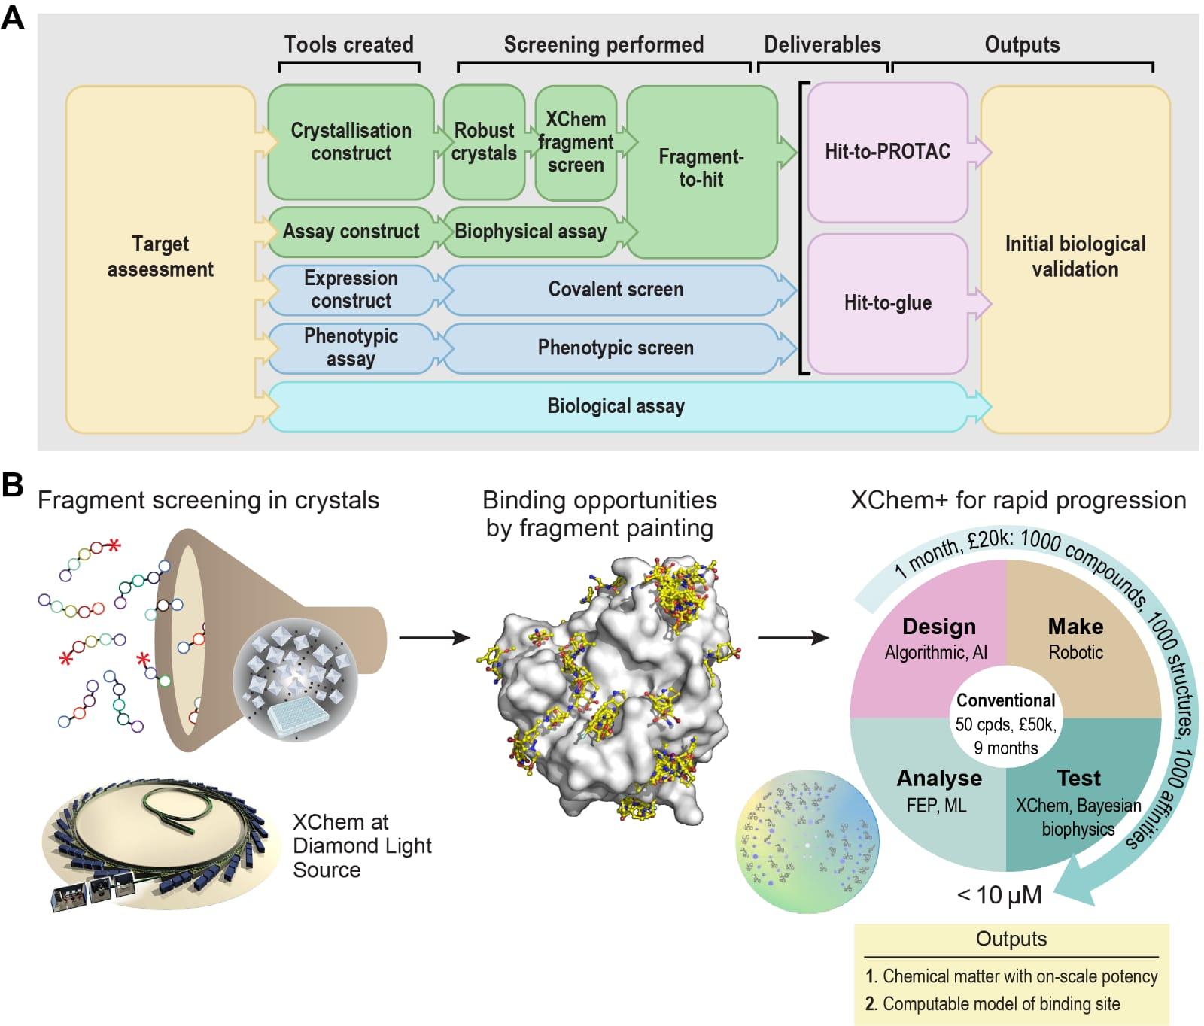
Fast Forward Fragments – structurally based follow-ups at scale

Slide 3
FFF as a User offering
Merging fragments
Human design
Fragmentstein
Knitwork
Effective experiments
Syndirella
HIPPO
PoseButcher
Data dissemination & collaboration
XChem Align (XCA)
Fragalysis
Chemistry and logistics
Chemist Assisted Robotics (CAR)
PyCule
Sensible signal from noise
PANDDA
MSCheck
Biophysics

Slide 4
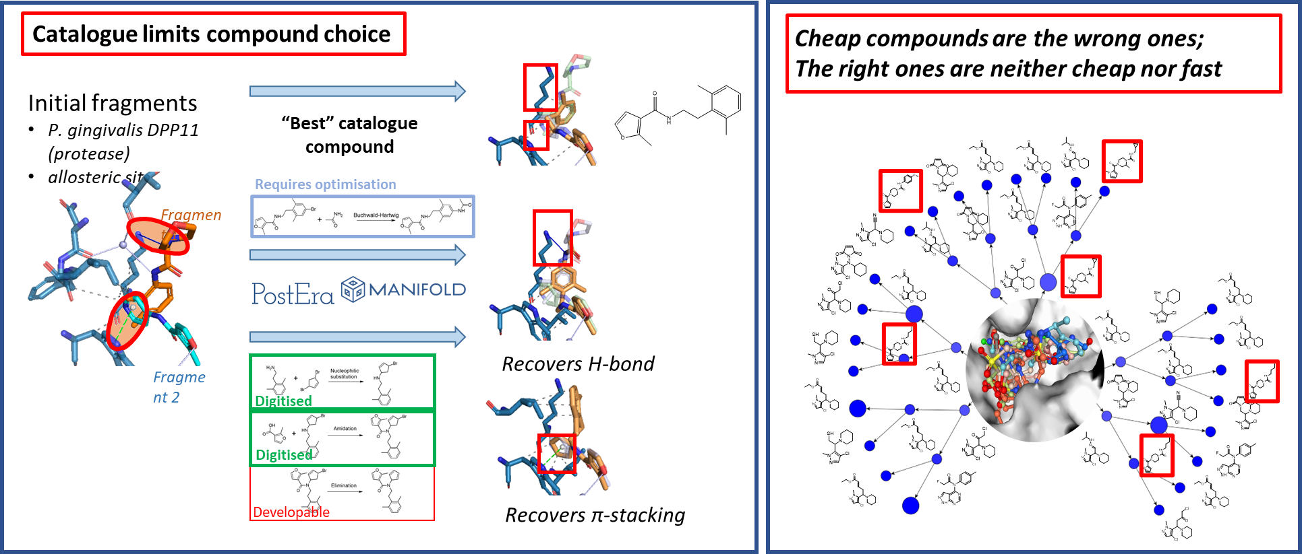
Catalogues limit fragment merge exploration space
CAR is driving fragment progression at XChem

Slide 5

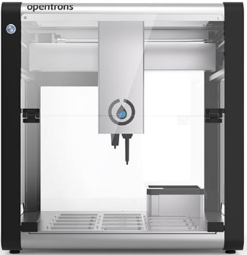
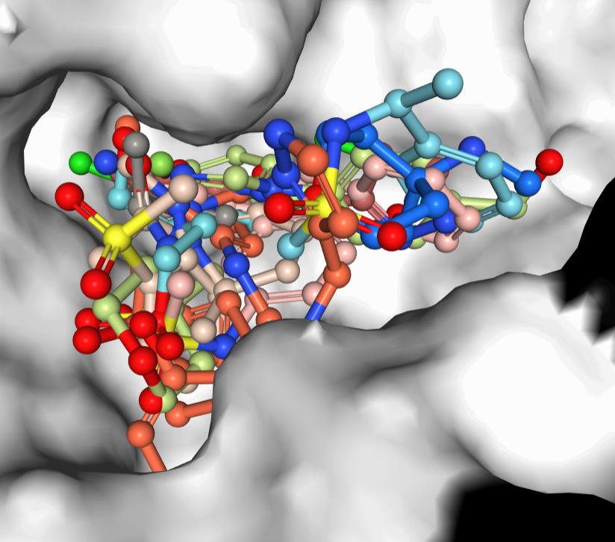
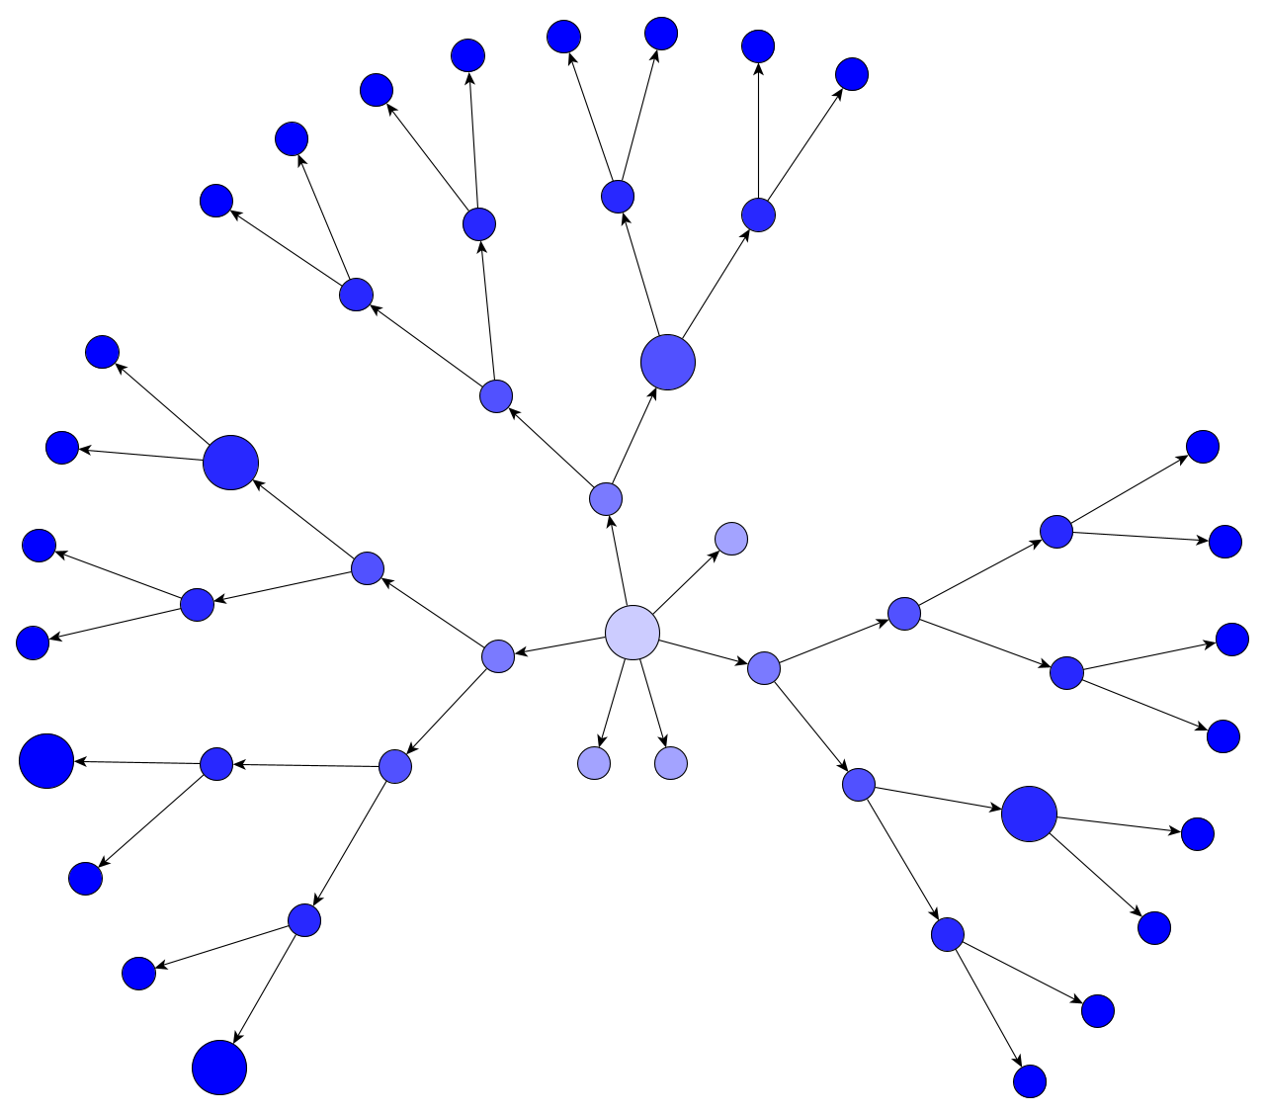


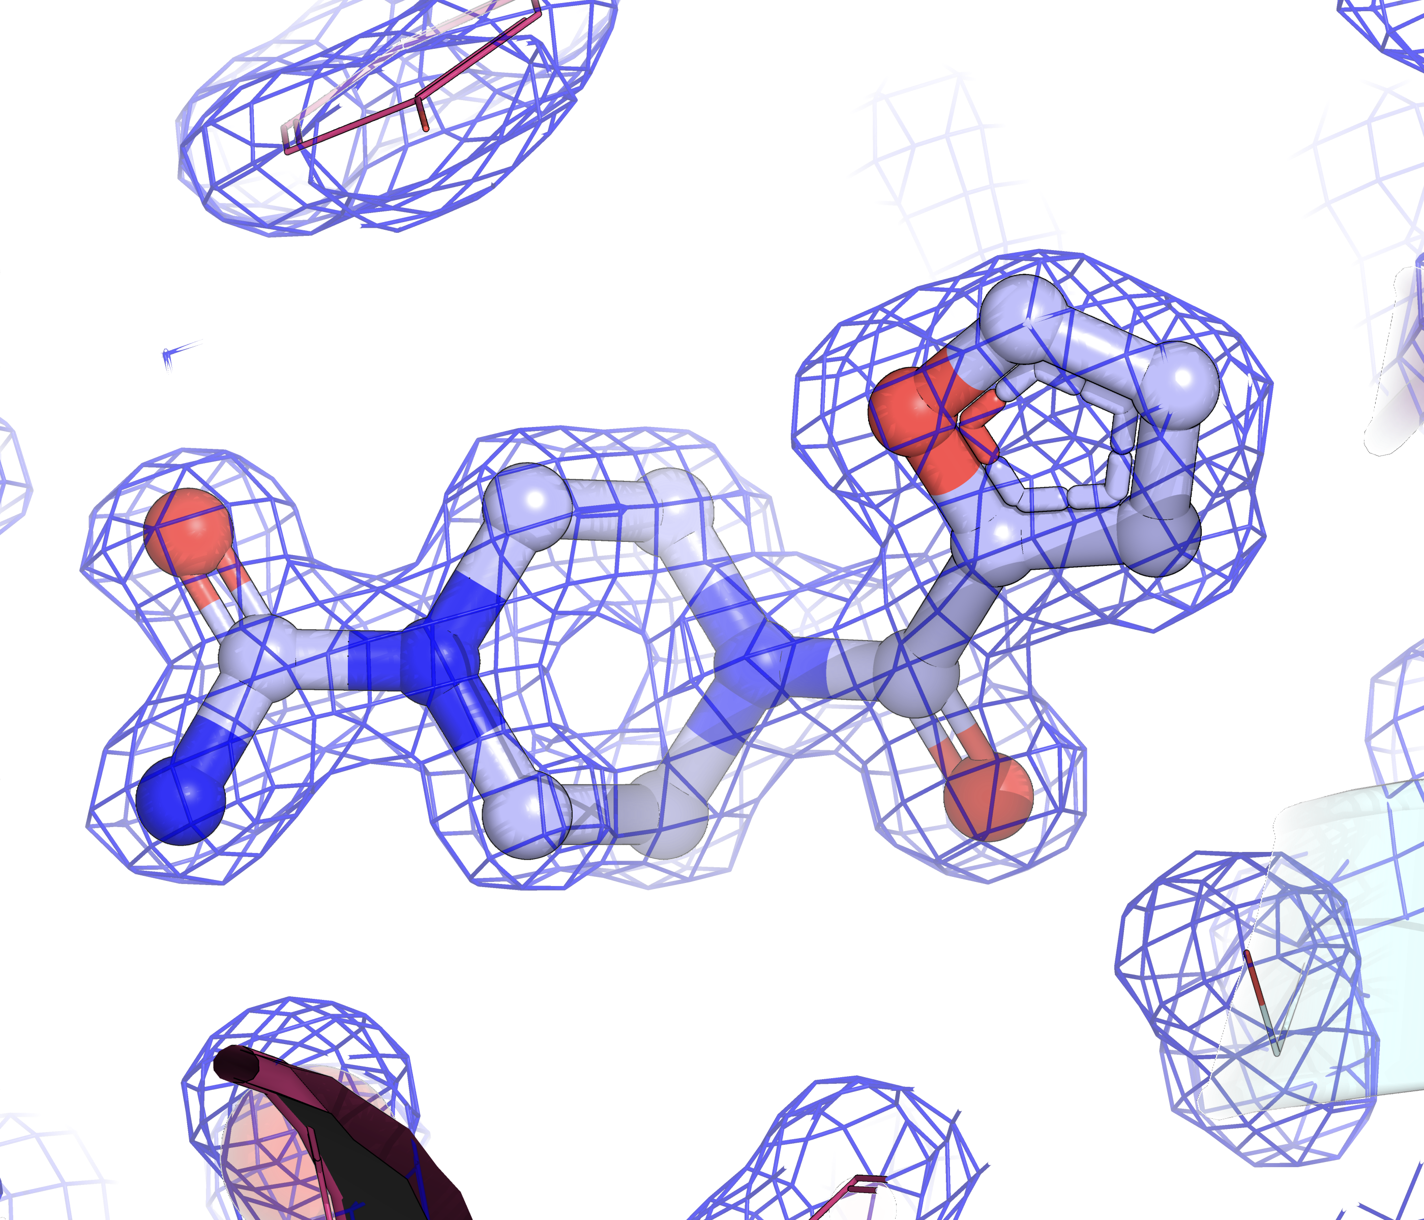

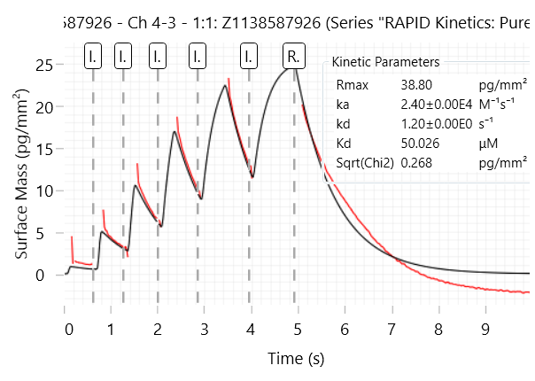
10 – 100x sampling of fragment merges within catalogue budget
_{Reaction pathways}
_{CAR}
_{Synthesis}
Expansion through building block analogue search
_{Review & triage}
_{CAR digitised}
_{Needs work}
_{Reject}
Retrosynthesis with digitised reactions
Order BBs and reaction optimisation
_{Merge enumeration}
_{Structure and biophysics}

Slide 6
10 – 100x sampling of fragment merges within catalogue budget
_{Reaction pathways}
_{CAR}
_{Synthesis}
Expansion through building block analogue search
_{Review & triage}
_{CAR digitised}
_{Needs work}
_{Reject}
Retrosynthesis with digitised reactions
Order BBs and reaction optimisation
_{Merge enumeration}
_{Structure and biophysics}
TRY-UNI-2eddb1ff-7

Slide 7
10 – 100x sampling of fragment merges within catalogue budget
_{Reaction pathways}
_{CAR}
_{Synthesis}
Expansion through building block analogue search
_{Review & triage}
_{CAR digitised}
_{Needs work}
_{Reject}
Retrosynthesis with digitised reactions
Order BBs and reaction optimisation
_{Merge enumeration}
_{Structure and biophysics}
TRY-UNI-2eddb1ff-7
Merge design and Manifold directed expansion points

Slide 8
10 – 100x sampling of fragment merges within catalogue budget
_{Reaction pathways}
_{CAR}
_{Synthesis}
Expansion through building block analogue search
_{Review & triage}
_{CAR digitised}
_{Needs work}
_{Reject}
Retrosynthesis with digitised reactions
Order BBs and reaction optimisation
_{Merge enumeration}
_{Structure and biophysics}
TRY-UNI-2eddb1ff-7
Merge design and Manifold directed expansion points

Slide 9
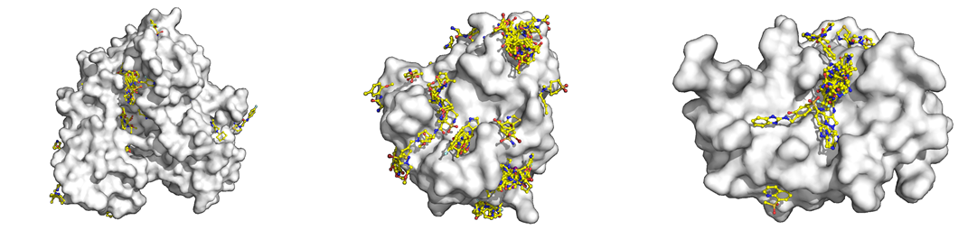
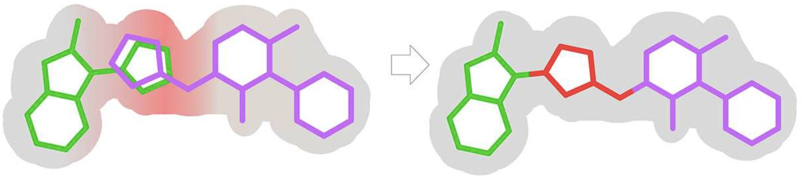
Fast Forward Fragments
Fragments
Merges
Elaborations
Retro-synthetic elaboration with Syndirella
Med-chemists for design & curation?
Sampling
Interaction and cost driven selection with HIPPO
Robotic Synthesis
Chemist Assisted Robotics platform at RCaH
Follow-Up Experiment

Slide 10
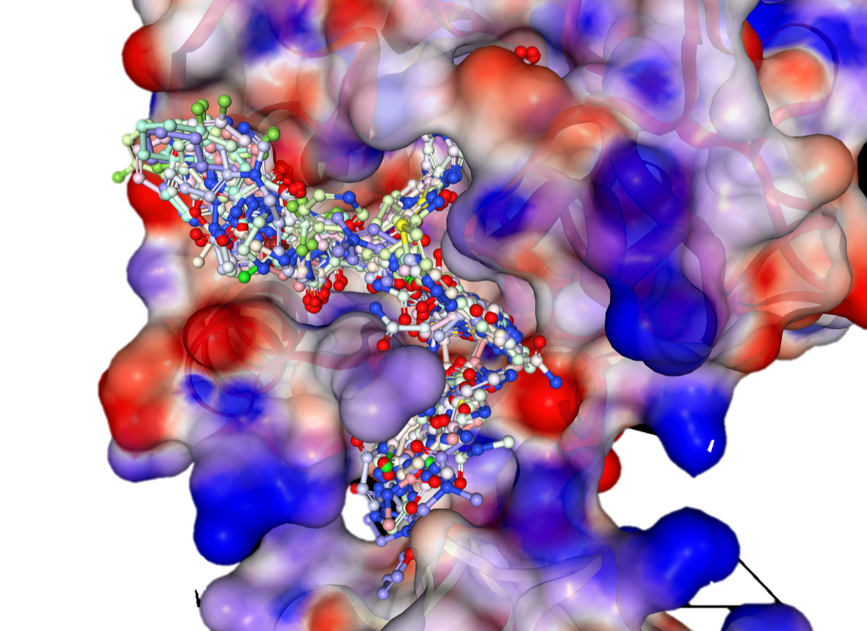
Fragment Screen
Bolus of fragments
Site / subsite | Count
ADP-ribose site | 299
Adenine subsite | 147
Oxyanion hole | 42
Phosphate subsite | 12
Ribose subsite | 28

Slide 11
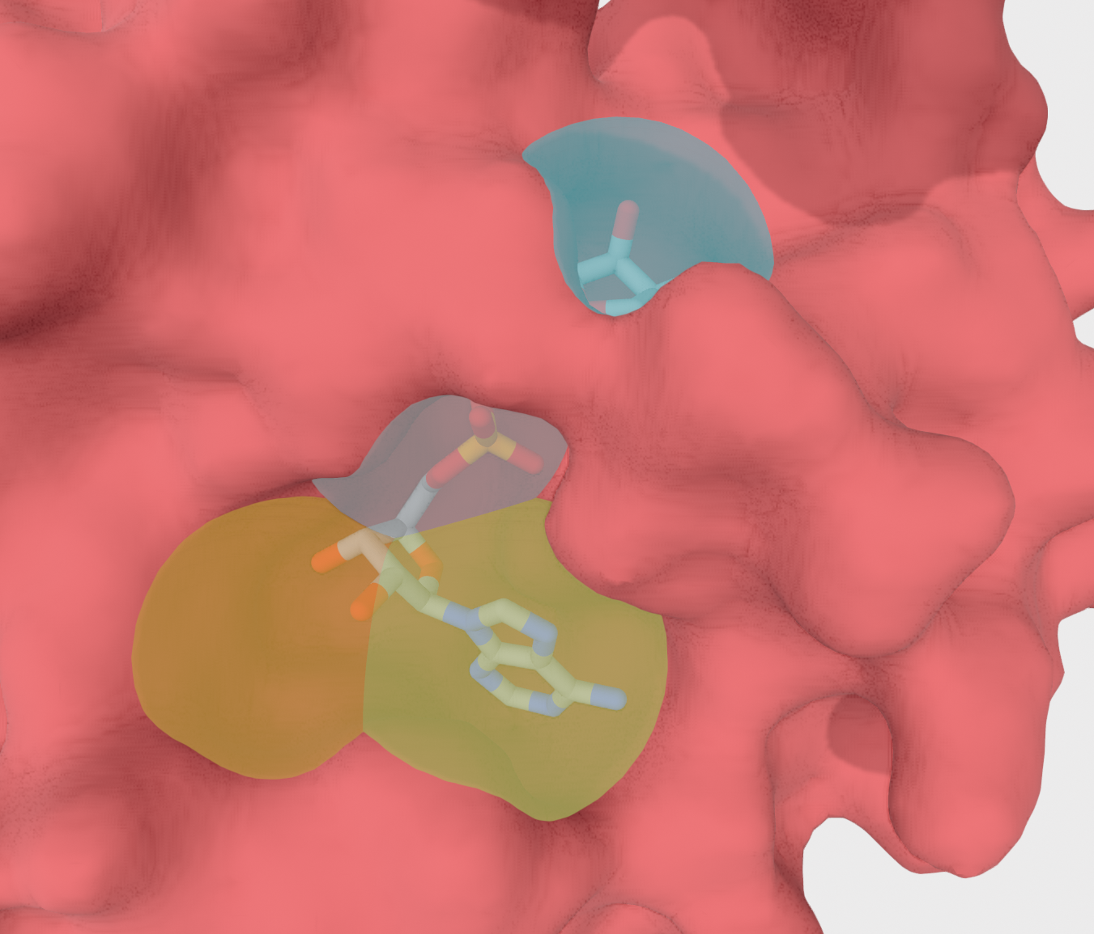
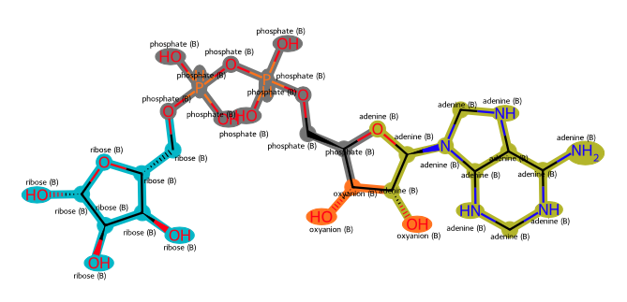
Algorithmic compound tagging
Dynamic definitions of the subpockets within the protein enabled by PoseButcher.
Virtual hits can be tagged and scored based on subsite and/or protein clashes.

Slide 12


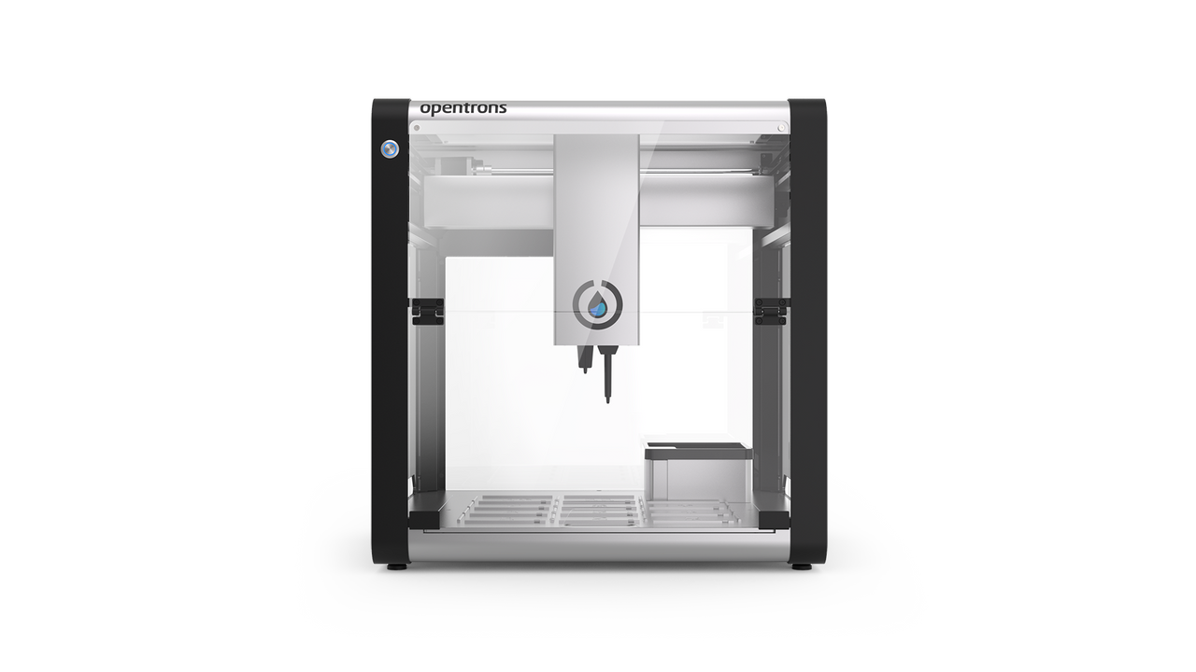
Formulaic Pipeline
Interaction driven compound set optimization
Profile and fingerprint protein-ligand interactions
Generate reactant (BB) subsets within a budget
Define follow-up priorities / experimental hypotheses
Rank and optimize the BBSs
CAR
Retrosynthesis Directed Elaborations
Start with fragment merges
Synthesis routes via Manifold
Vary reactants while constraining reaction sites
Rapid combinatorial expansion of product comps.
Placed w/ Fragmenstein
Digitized chemistry platform for rapid (<4 weeks) and low-cost (<£10k) follow-ups
Multi-step synthesis to escape the catalogue
Encoded recipes for adding and optimizing new chemistry
Oxford / Kate Fieseler
Diamond / Max Winokan
Diamond / Warren Thompson

Slide 13
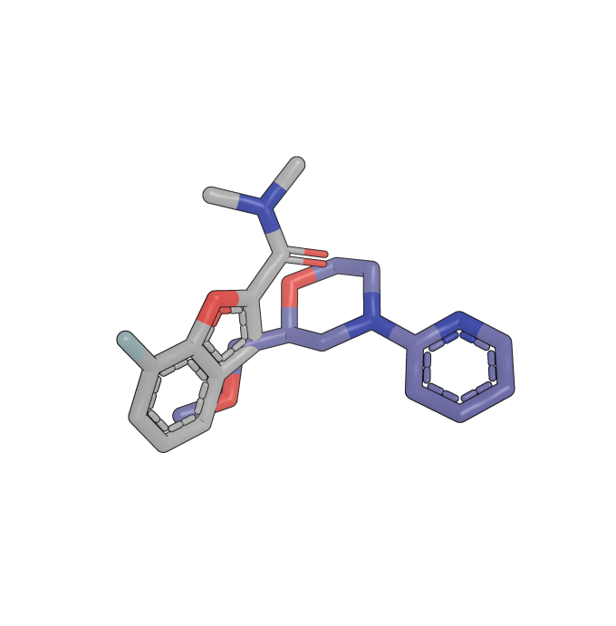
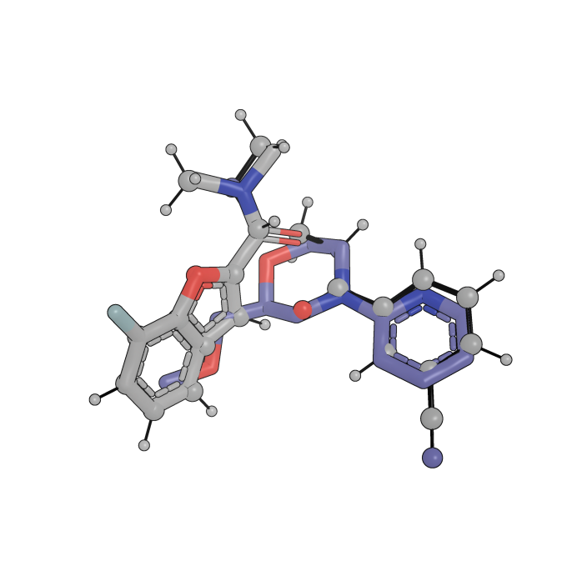
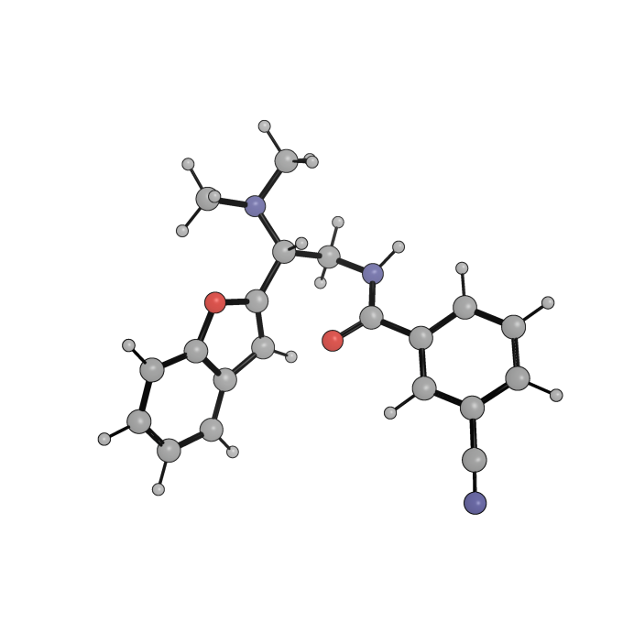

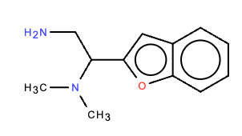
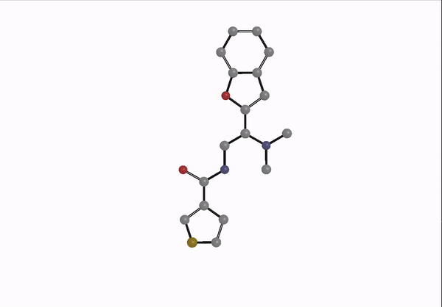
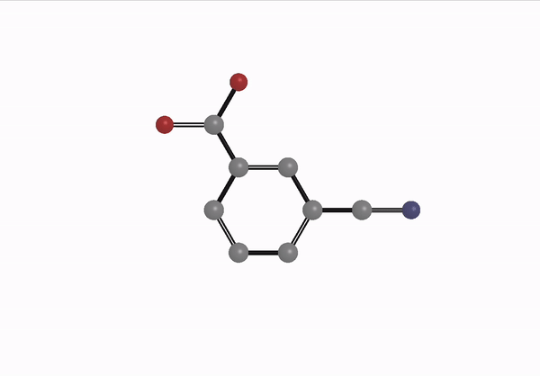
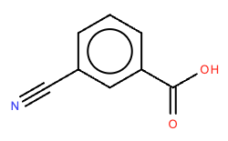
Elaboration around merges
INPUT:
Retrosynthesis search
Chemist
Algorithmic
Reactants
Inspiration fragments
Merged compound
Amidation
OUTPUT:
Primary amine
Superstructure search of reactants in catalogues
Carboxylic acid
Notes:
Example: /Users/kate_fieseler/PycharmProjects/retrievesynthesizable/NCS1/sept4_elab/CSSB03437012178-x0119-0B-x0128-0B/Amidation_CN(C)C(CNC(=O)c1cccc(C#N)c1)c1cc2ccccc2o1/frag_placed

Slide 14
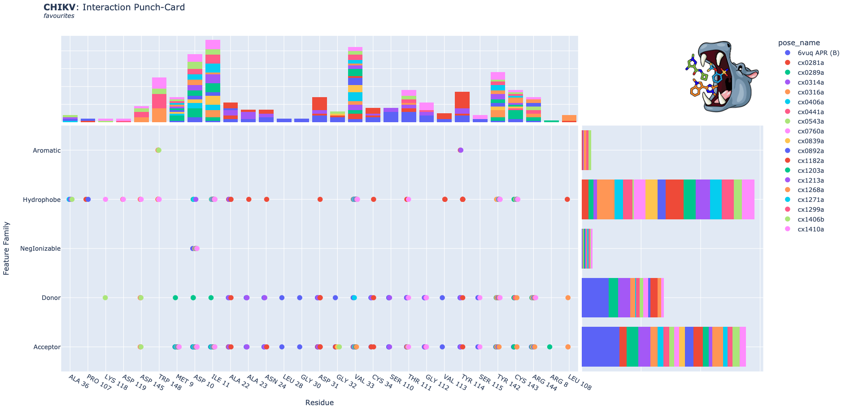
Fragment Screen

Slide 15
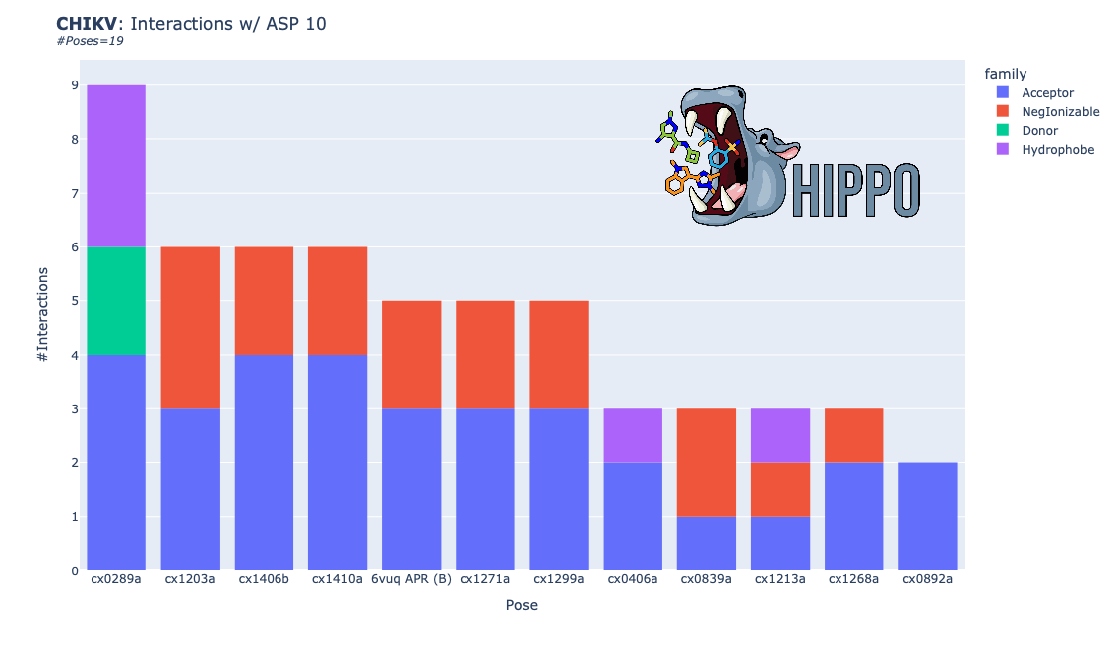
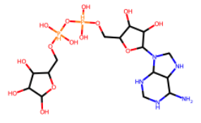
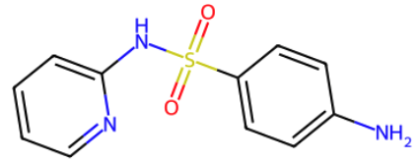
Fragment Screen
Interactions by residue:
ASP 10
ILE 11
CYS 143
ARG 144
TRP 148

Slide 16
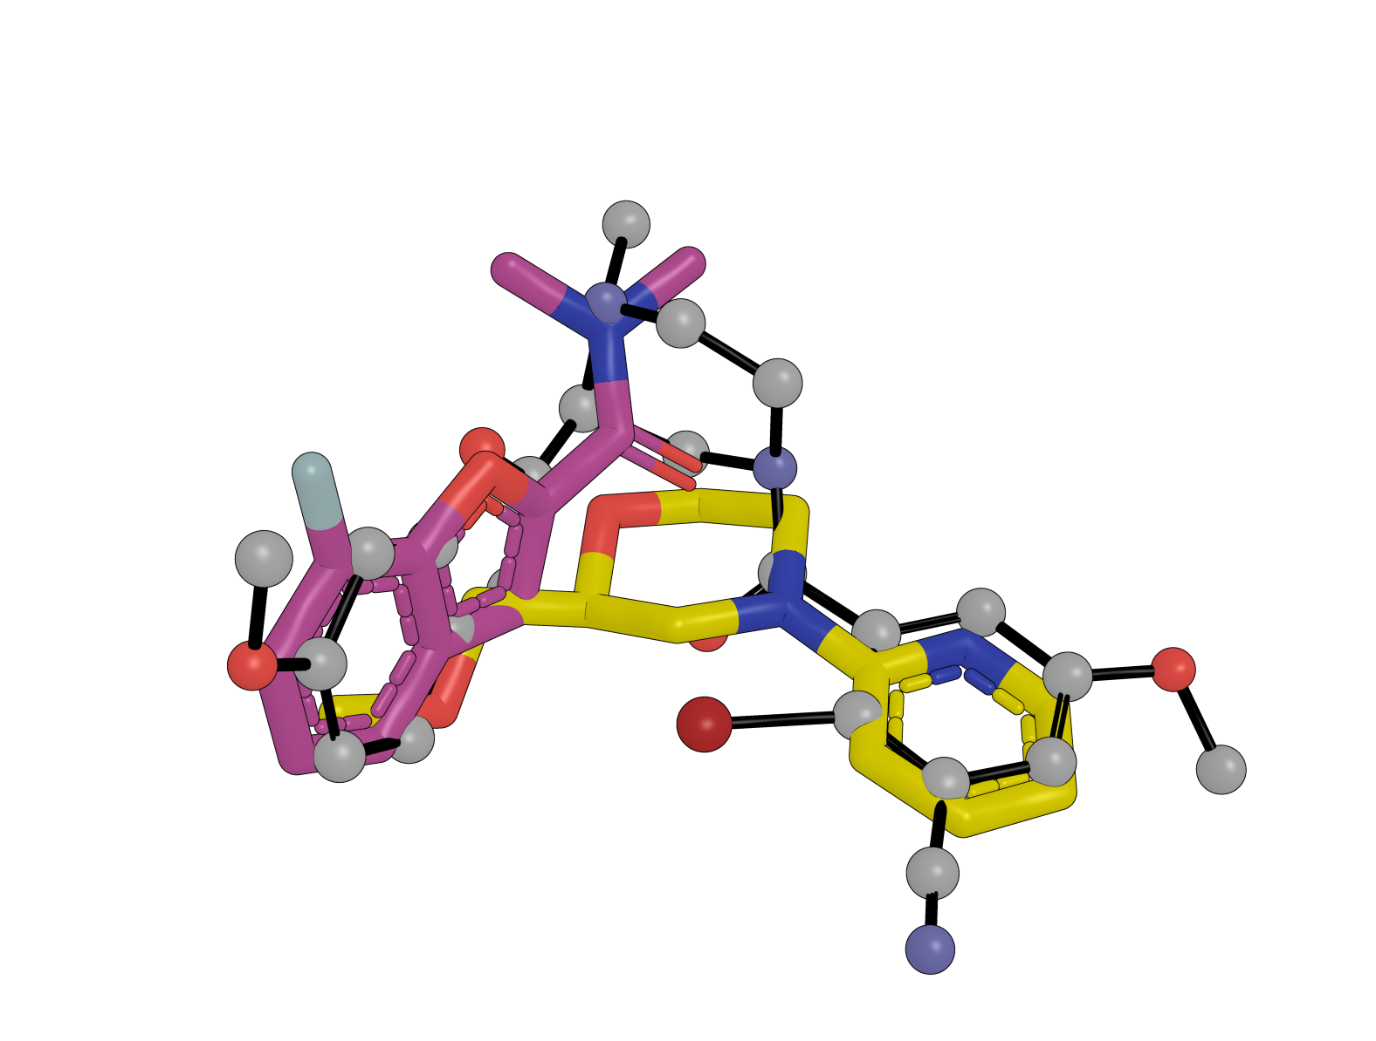
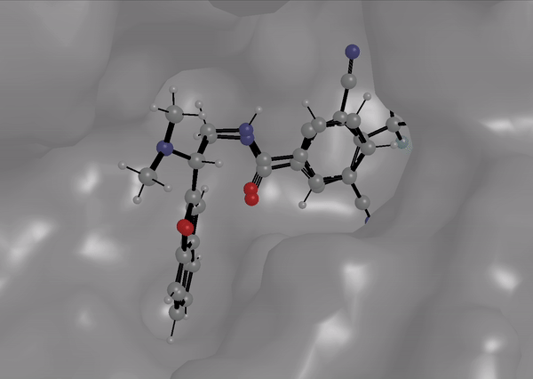
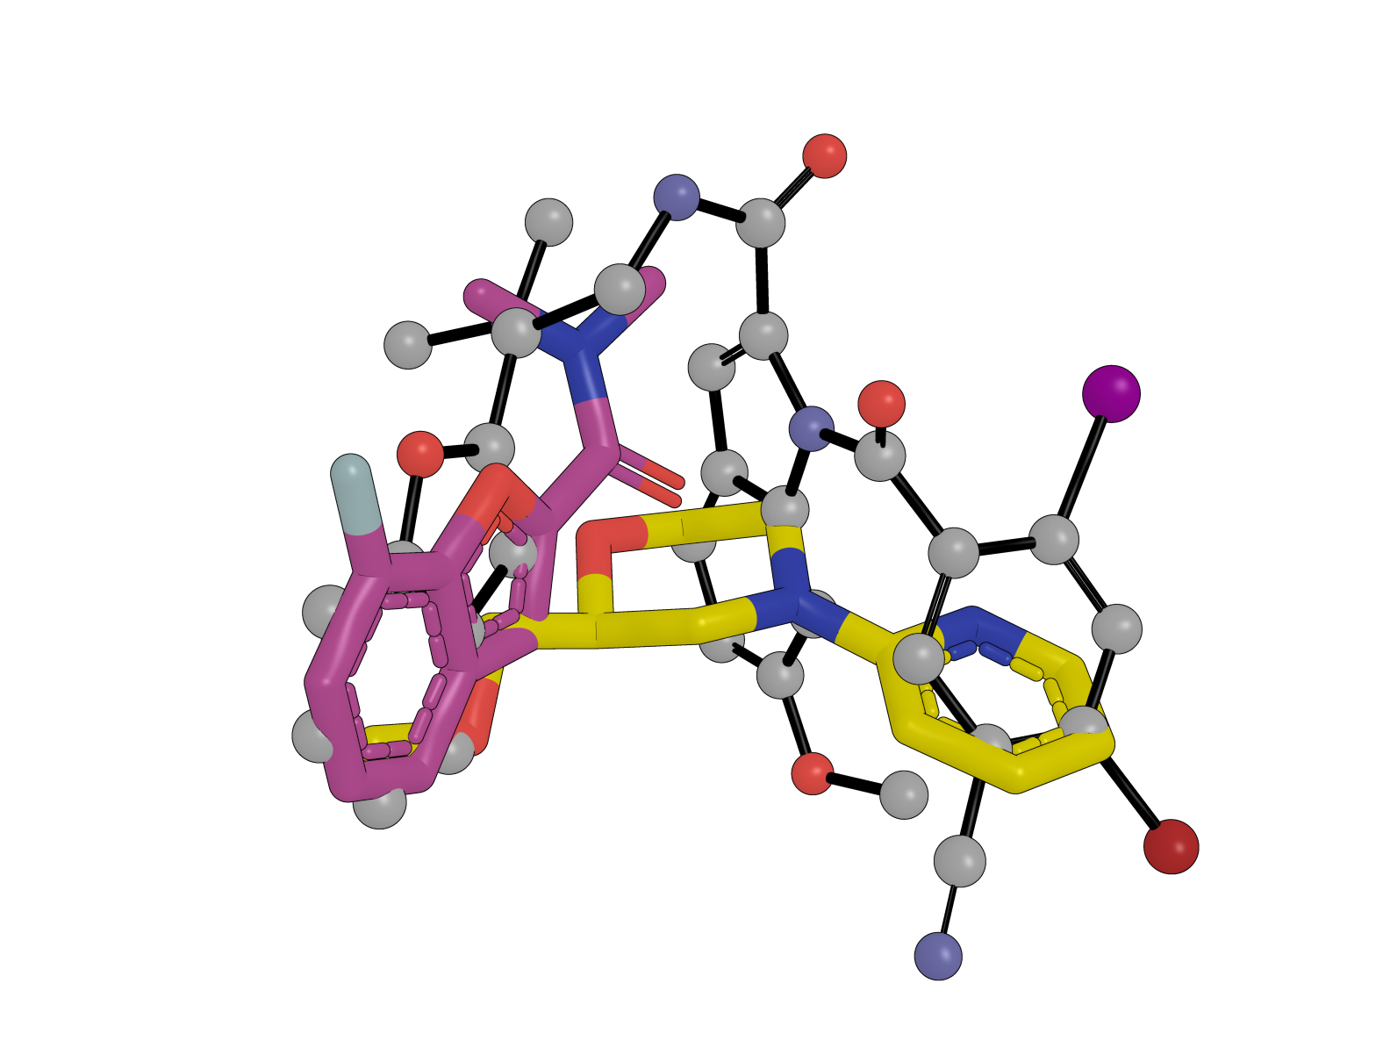
Pose prediction
Successful placement
RMSD = 0.79 Å
Elaborated compounds placed in comparison to fixed original merged compound
Unsuccessful placement
RMSD = 2.33 Å

Slide 17
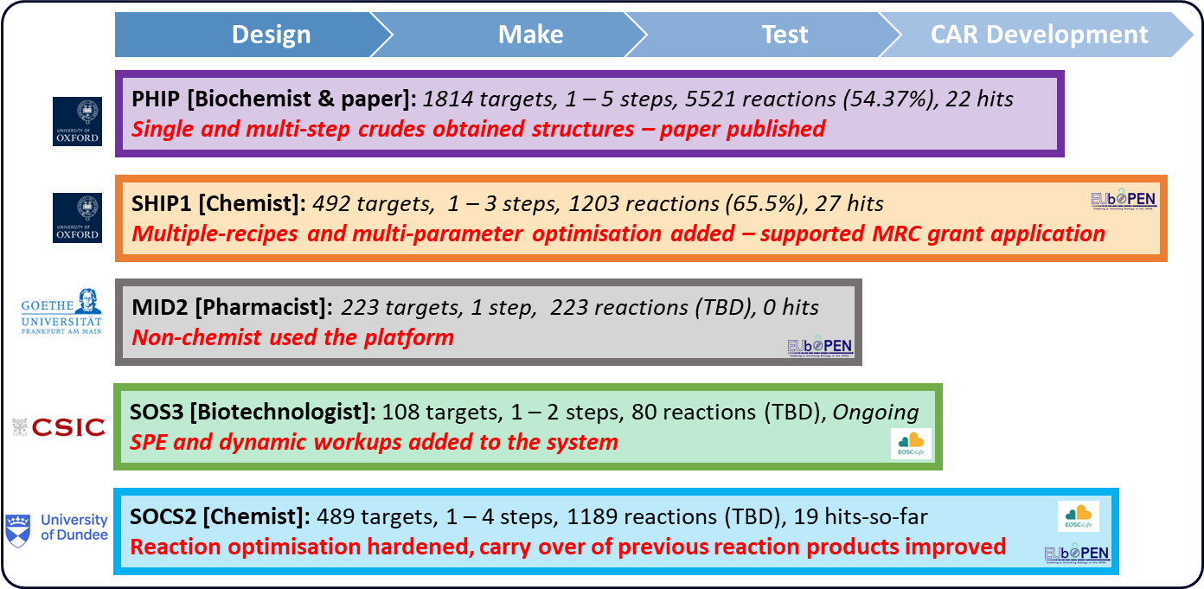
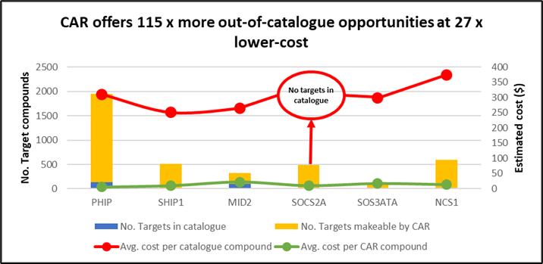
FFF is driving fragment progression at XChem
CAR is driving fragment progression at XChem
Developing Chemist Assisted Robotics (CAR) through EUbOPEN and ASAP partnerships ​
1000-compound fragment expansions – designed hypotheses (not combichem!), crudes on crystals​
Proofs-of-principle: Grosjean 2023 chemRxiv; 5 collaborators in 2022/23 (incl. 500 µM glue in 2mths…)
A
B

Slide 18
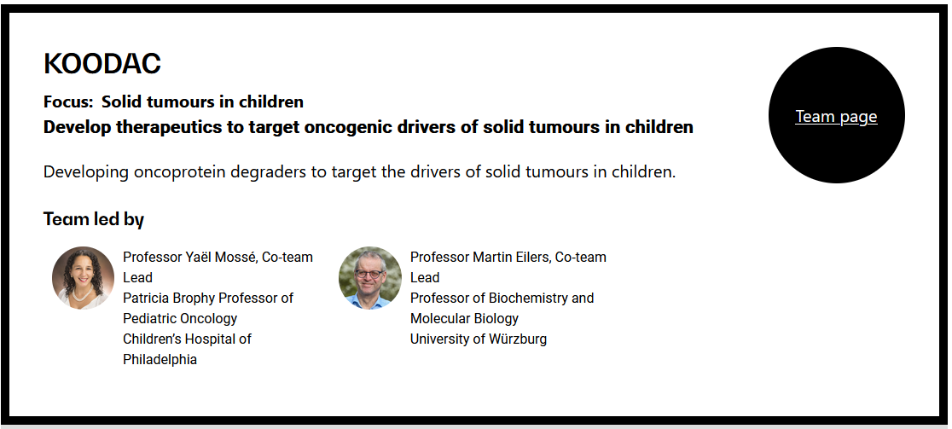
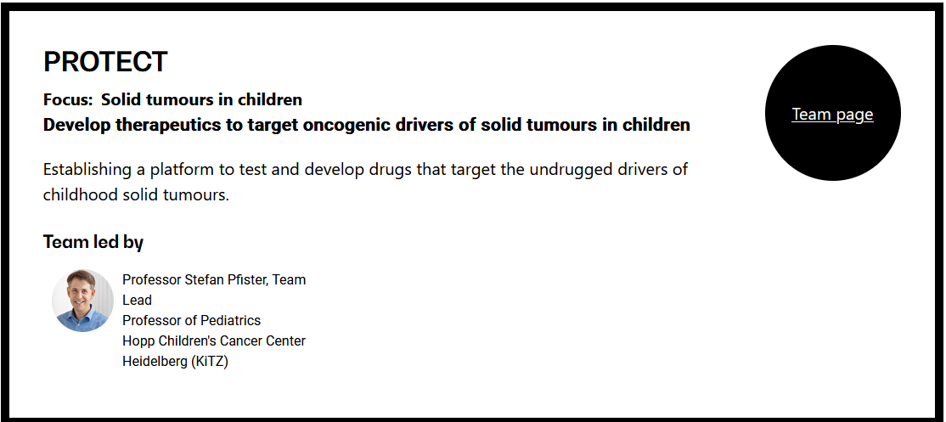
FFF is driving fragment progression at XChem
CAR is driving fragment progression at XChem
Open Science Drug-discovery
Support proposals/grants
A
B

Slide 19



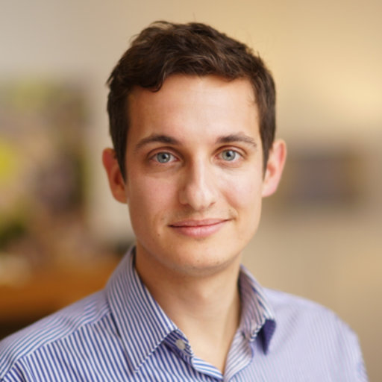
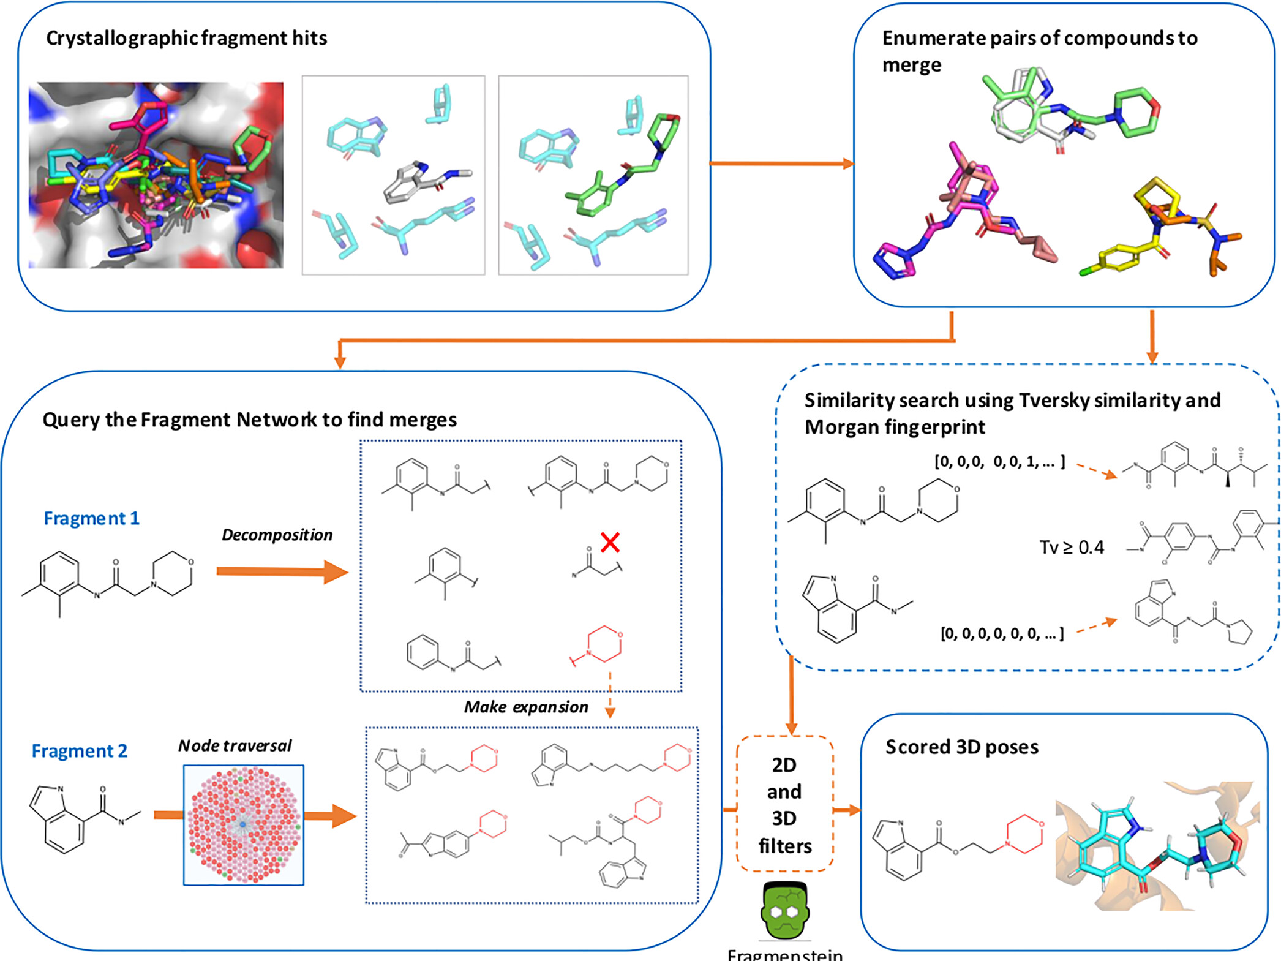
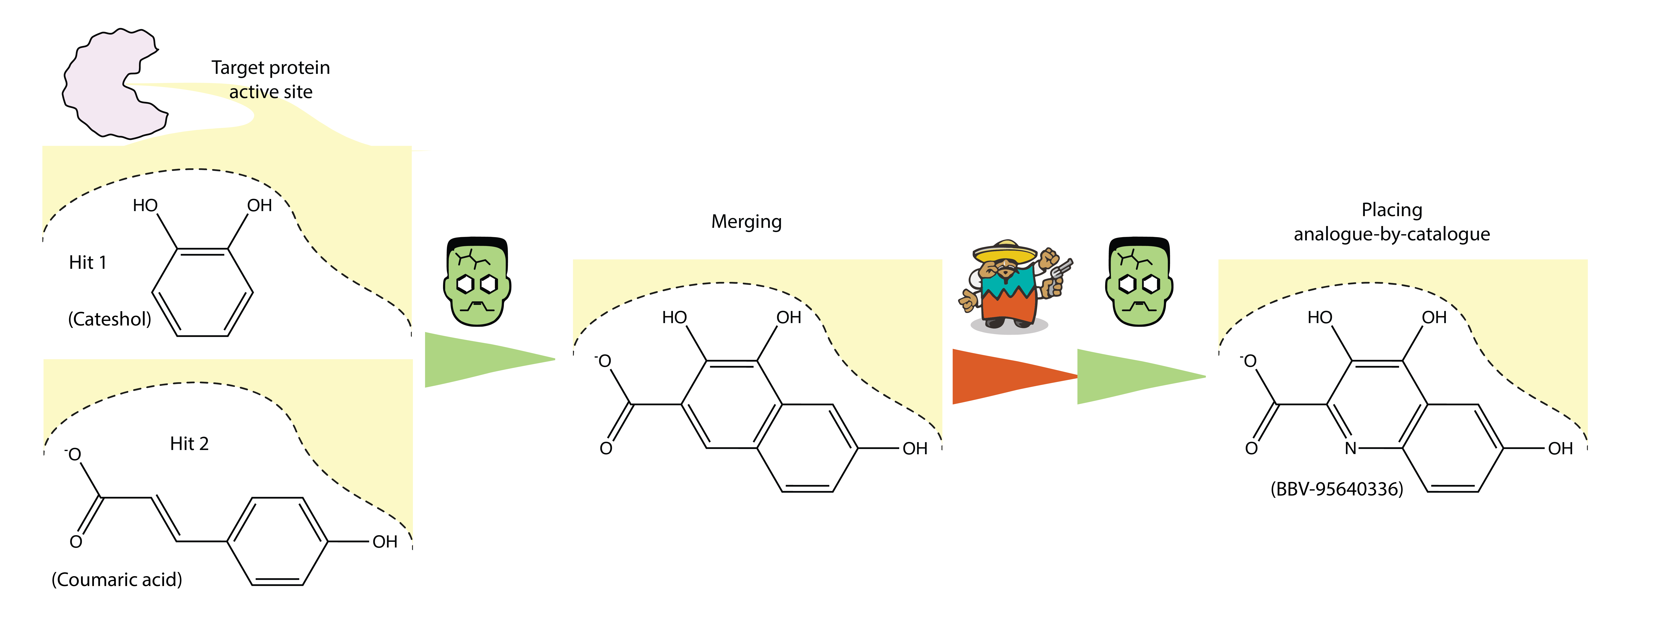

Algorithmic Merges
The Fragment Network
Fragmenstein
Steph Wills
Matteo Ferla
OUTPUT:
First iteration follow-up designs direct from experimental data
Wills, S et al. J Chem Inf Model 2023, 63 (11), 3423–3437

Slide 20
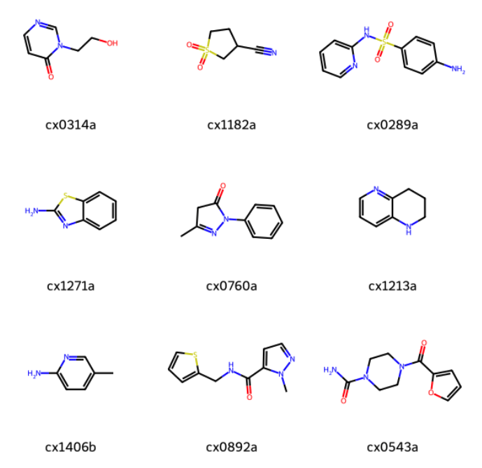
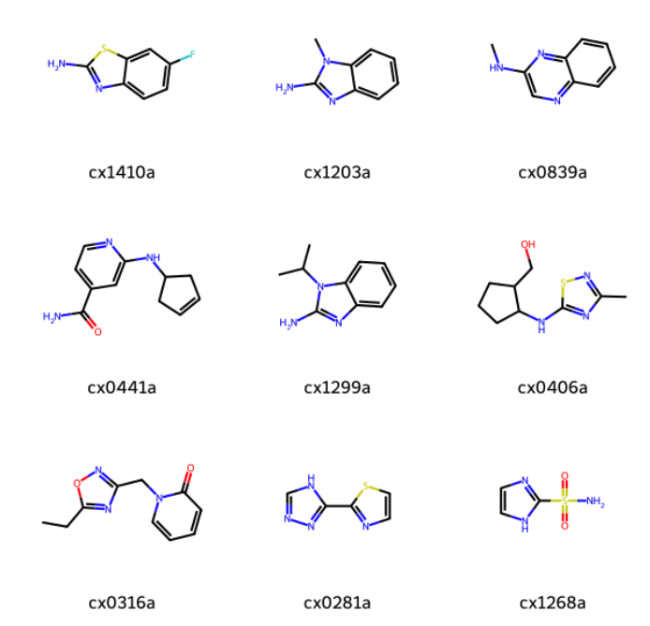
Jasmin’s Favourite Hits

Slide 21
Potential merges
https://fragalysis.diamond.ac.uk/viewer/react/projects/41/36
Merge: 0892a with 1406b, 1213a, 1271a, 1213a, 1410a, 0839a
Merge: 0406a and 1406b, 1213a, 1271a, 1213a, 1410a, 0839a
Merge: 1182a and 0314a
Merge: 0289a and 1406b, 1213a, 1271a, 1213a. 1410a, 0839a
Merge: 0316a and 0543a. 0441a
Spiro: 0892a and 0314a

